Slide 1
Lebanon and Syria Displaced Crisis Challenges and Risks
LARP Mission IV to Lebanon
"Solidarity with Lebanon –
Reform, Security & Stability"
Ziad El Sayegh
Expert in Public Policies and Refugees
1/9/2017

Slide 2
Lebanon and Syria Displaced
Content
Lebanon and Syria Displaced: Background
Lebanon and Syria Displaced: Challenges / Risks
Lebanon and Syria Displaced: Exhausted Infra-Structure
International Community support to Lebanon in facts
Conclusion / Key Interrogations

Slide 3
Lebanon and Syria Displaced Background
Lebanon received 1.5 million displaced from Syria since 2011
Lebanon historically had between 400.000 and 600.000 Syrians working in Agriculture, Construction, and Infra-structure sectors
Lebanon between the years 2011 – 2013 did not admit the presence of a displaced crisis
Lebanon between the years 2013 – 2016 could not elaborate a National Policy towards the Syria displaced crisis due to the political conflicts
December 2016 was fundamental after the nomination of P.M. Saad Hariri Government, where it founded the Ministry of State for the Displaced Affaires to handle the complications of this issue

Slide 4
Lebanon and Syria Displaced Challenges
Lebanon is facing due to the Syria Displaced several challenges:
Political (conflicts – contradicting agendas - …)
Sovereign ( Legal – Security – Diplomatic)
Economic – Social – Environmental (Infra-structure – population density – poverty in resources - …)
Psychological (the history of Lebanese – Syrian relation and its future)
All these challenges should have been faced through a comprehensive national policy , but the political conflict inhibited this
There is dereliction from the International Community in the elaboration of a political solution to cease the war in Syria preluding the return of the displaced
There is a retreat in the size of the support to Lebanon, for the displaced and for the hosting communities.

Slide 5
Lebanon and Syria Displaced Political Risks
Demagogy
Populism
Polarization
Exploitation
Phobia
Reaction

Slide 6
Lebanon and Syria Displaced Exhausted Infra-Structure
The impact on the Economy
1- Drop in economic growth: The crisis directly affected main key economic sectors and negatively impacted investment due to internal unrest and uncertainty
Drop in economic growth from 7% in 2010 to 0-1% in 2015
Decrease in the rate of the real GDP growth to 5% in comparison with the estimates of 7% annually before the crisis (2017 is still under estimation)

Slide 7
Lebanon and Syria Displaced Exhausted Infra-Structure
The impact on the Economy
2- Negative impact on the Tourism Sector: through internal political divergence and security instability
Contribution of tourism & travel sector in the GDP decreased from 29% in 2010 to 19% in 2014 (= 8.6 billion $)
3- Deterioration of Public Finance: which resulted in the increase of its deficit
Deficit increased from 5.9% of GDP in 2011 to 9.5% of GDP in 2013

Slide 8
Lebanon and Syria Displaced Exhausted Infra-Structure
The impact on the Economy
4- A decline in foreign investment
5- Deterioration in the Balance of Payments
6- A decline in the activity of the real estate sector
7- A decline in the trade sector

Slide 9
Lebanon and Syria Displaced Exhausted Infra-Structure
The impact on Health
1- Health Sector: suffering from pressure, from an increase in demand on health services and increase in health costs; with insufficient number of workers in the domain and the spread of illness and diseases
Syria displaced constitute 40% of the total number of primary healthcare cases

Slide 10
Lebanon and Syria Displaced Exhausted Infra-Structure
The impact on Education
2- Education Sector: is facing many challenges due to the increase in the Syria displaced in public schools:
Unorganized classes supervised by NGOs
Incapacity of displaced to afford school tuition & transportation fees
No available places in schools
Social, educational, & language differences and differences in curricula

Slide 11
Lebanon and Syria Displaced Exhausted Infra-Structure
The Infra-Structure
The infra-structure was already in a flabby state before the Syrian crisis due to overpopulation in some regions, as well as weak maintenance and rehabilitation; it is also technically and administratively unprepatedand does not have the financial capacities to answer to the needs and demands of Syria displaced and support their numbers

Slide 12
Lebanon and Syria Displaced Exhausted Infra-Structure
The impact on the Infra-Structure
1- Water and Sanitation Sector: Overflow of Syria displaced is causing an increase in demand on water supply as well as sanitation services
The demand of Syria displaced increased the total demand by 7%

Slide 13
Lebanon and Syria Displaced Exhausted Infra-Structure
The impact on the Infra-Structure
2- Solid Wastes: Quantities of solid wastes produced increased causing pressure on the infra-structure for solid waste management; it is also increasing municipalities expenditures and polluting water resources and ground water
Solid wastes produced annually by Syria displaced = 15.7% of wastes produced by Lebanese population
Municipalities expenditure increased by 40%

Slide 14
Lebanon and Syria Displaced Exhausted Infra-Structure
The impact on the Infra-Structure
3- Electricity: The current production capacity of electricity is continuously deteriorating due to the flabby plants & technical losses of EDL as well as the insufficient production capacity of the Turkish steamboats.
Syria displaced increased the pressure on electricity consumption and increased the demand by 20%

Slide 15
Lebanon and Syria Displaced Exhausted Infra-Structure
The impact on the Infra-Structure
4- Road Transportation Sector
The sector witnessed an increase between 15% to 50% in road traffic according to the regions
Significant decrease in transport trucks transit services by > 65% due to the economic slowdown

Slide 16
Lebanon and Syria Displaced
The impact on the Job Market
The Lebanese economy suffers from structural problems which hinders it from creating sufficient job opportunities and from answering local employment needs.
The overflow of Syria displaced lead to negative and deep repercussions in the job market:
1- Increase in the unemployment rate: Working Syria displaced particularly affected young people, women, skilled workers and university degree holders
Unemployment increased from 11% to 12% according to World Bank – to 29% according to ESCWA (from 220.000 to 324.000 persons)

Slide 17
Lebanon and Syria Displaced
The impact on the Job Market
2- Expansion of an unorganized labor: Unorganized Lebanese labor constitute > half of the labor. It is unskilled & concentrated on construction, agriculture & industrial sector.
The flow of Syria displaced expanded the unorganized scope due to the work of 92% of displaced in low-skilled domains
3- Reducing the Salaries: This mainly affects the middle class, which increases social and living problems as well as tension between the displaced and the Lebanese in poor areas.
The average monthly income of a displaced is 40% less than the minimum wage in Lebanon

Slide 18
Lebanon and Syria Displaced
The impact on the Job Market
4- Illegal and unfair competition on job opportunities: Job opportunities decline and unemployment increases.
Syria displaced accept to work in return for salaries lower than the salaries of Lebanese workers and without health and social insurance, for longer hours, and without registering in the National Social Security Fund.
Before the crisis, Syrian workers used to work in seasonal agriculture, construction, & local services. However, they are now present in all economic sectors (as tourism & trade) and in all professions (handicraft, pharmacy, engineering, medicine, taxi drivers, …)
Syrian displaced began competing in trade by establishing SMEs (commercial shops, restaurants)

Slide 19
Lebanon and Syria Displaced
The impact on Poverty
The poverty crisis spread due to the spread of Syria displaced in the poorest & most deprived areas in Lebanon (64% of the displaced are distributed between Bekaa and the North)
Displaced are sharing scarce resources with the Lebanese who are already living under the line of poverty
Food inflation, Consumer Goods Inflation & Rent Inflation
Increase in unemployment and decrease in income in poor areas

Slide 20
International Community support to Lebanon (Facts)
Funds committed in 2017
by donors (as of 30/6/2017)
1.190.833.068 $

Slide 21
International Community support to Lebanon by Sector
Sector | % of Funds
Basic Assistance | 26%
Child Protection | 1%
Education | 13%
Energy | 3%
Food Security | 18%
Health | 11%
Livelihood | 7%
Protection | 3%
SGBV | 1%
Shelter | 4%
Social Stability | 4%
Water | 10%
Only 19% of the funds were received till date

Slide 22
Conclusion/ Key Interrogations
Dignity under sovereignty until the return
The return of Syria displaced to Syria is a priority
Their humanitarian protection until the return is a priority
The respect of the sovereignty of Lebanon is a priority
Can the Displaced crisis be solved with relief funds?
Can the hosting societies crisis be solved with developmental funds?
How to complement between relief and developmental?
What relation exists between extremism – terrorism and the displaced crisis?
What about Good Governance in the presence of political conflict and absence of unifying national policy?
What about Existential challenges and the Identity impasse?
What about the return diplomacy?
Can we turn this crisis into an opportunity?

Slide 23
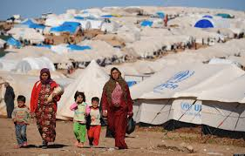
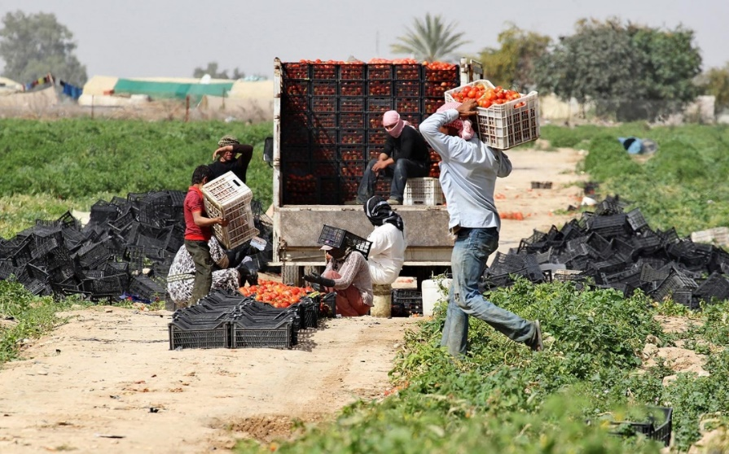
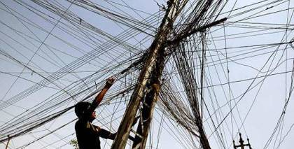
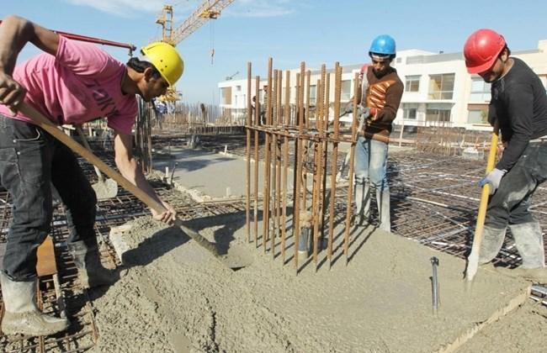
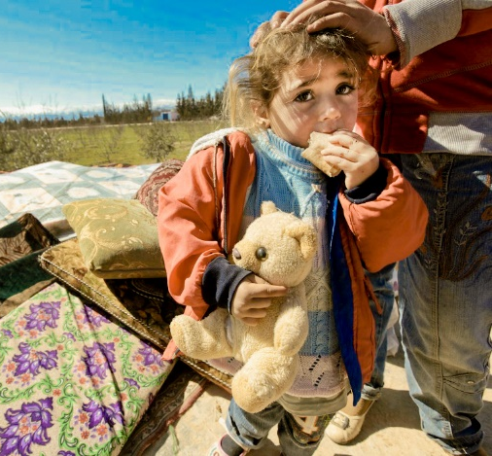
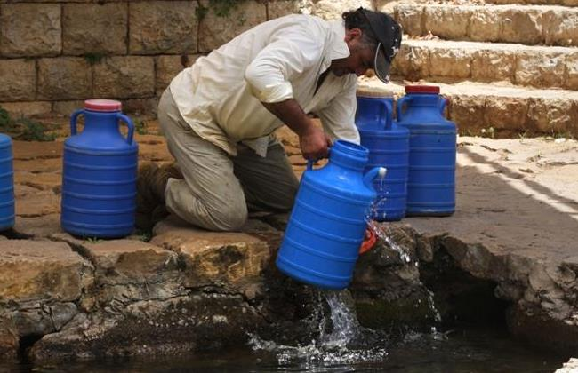
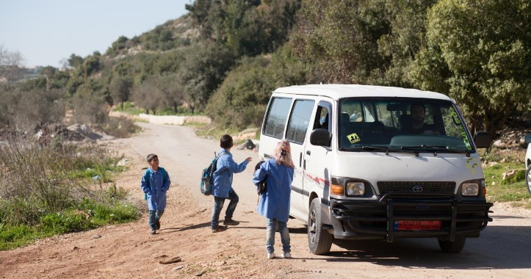
Thank You

Slide 24
Bibliography
Emerging Lebanon – Towards Economic Growth and Social Welfare / Roger Nasnas – Dar Annahar - 2016
https://www.ncbi.nlm.nih.gov/pmc/articles/PMC4948691/
The Lebanese–Syrian crisis: impact of influx of Syrian refugees to an already weak state
Zeinab Cherri, Pedro Arcos González, and Rafael Castro Delgado
https://www.wilsoncenter.org/event/humanitarian-crisis-impact-syrian-refugees-lebanon
http://www.sciences-po.usj.edu.lb/pdf/The%20Syrian%20Crisis%20%20its%20Implications%20on%20Lebanon%20-%20Khalil%20Gebara.pdf
http://journal.georgetown.edu/the-economic-impacts-of-syrian-refugees-challenges-and-opportunities-in-host-countries/
The Economic Impacts of Syrian Refugees: Challenges and Opportunities in Host Countries
By Ali Fakih and Walid Marrouch / November 10, 2015
http://www.tajaddod.org/pdf/the-effect-of-the-syrian-crisis-on-lebanon.pdf
IMF Country Report No. 17/20

Slide 25
http://civilsociety-centre.org/paper/regional-differences-conditions-syrian-refugees-lebanon
http://www.databank.com.lb/docs/The%20Economic%20Burden%20of%20Lebanese%20Hospitality%20-Blominvest-2017.pdf
The Economic Burden of Lebanese Hospitality During the Syrian Crisis
http://www.sciences-po.usj.edu.lb/pdf/The%20Syrian%20Crisis%20%20its%20Implications%20on%20Lebanon%20-%20Khalil%20Gebara.pdf
http://reliefweb.int/report/lebanon/refugees-syria-lebanon-march-2015
The impact of the Syrian crisis on Lebanon: Small advantages, huge damage, and overwhelming racism
http://english.al-akhbar.com/node/23099
Economic impact of Syrian displacement endured primarily by the poor in Lebanon
http://english.al-akhbar.com/content/economic-impact-syrian-displacement-endured-primarily-poor-lebanon
ASSESSMENT OF THE IMPACT OF SYRIAN REFUGEES IN LEBANON AND THEIR EMPLOYMENT PROFILE
http://www.ilo.org/wcmsp5/groups/public/@arabstates/@ro-beirut/documents/genericdocument/wcms_240130.pdf
How the war on Syria left its mark on Lebanon's economy / Author Elias al-Araj May 13, 2016
http://www.al-monitor.com/pulse/business/2016/05/lebanon-syria-war-economy-repercussions-banking-sector.html#ixzz4qsTuDKQC

Slide 26
http://www.worldbank.org/en/news/press-release/2017/04/21/new-support-for-refugees-and-host-communities-in-jordan-and-lebanon-brings-total-concessional-financing-to-us-1-billion
https://ec.europa.eu/echo/files/aid/countries/factsheets/lebanon_syrian_crisis_en.pdf
http://reliefweb.int/report/lebanon/syrian-refugee-crisis-lebanon-state-fragility-and-social-resilience
Impacts of the Syrian crisis in Lebanon: civil society as a vector of solidarity
Dr Kamel Mohanna • Président de Amel Association International et coordinateur général du collectif des ONG libanaises et arabes
http://alternatives-humanitaires.org/en/2017/03/10/impacts-of-the-syrian-crisis-in-lebanon-civil-society-as-a-vector-of-solidarity/
https://www.files.ethz.ch/isn/166941/lebanons_fragile_economy.pdf
Faysal Itani RAFIK HARIRI CENTER FOR THE MIDDLE EAST
Syria’s War Threatens Lebanon’s Fragile Economy
http://www.worldbank.org/en/news/feature/2013/09/24/lebanon-bears-the-brunt-of-the-economic-and-social-spillovers-of-the-syrian-conflict
Lebanon Bears the Brunt of the Economic and Social Spillovers of the Syrian Conflict - September 24, 2013
LEBANON ECONOMIC AND SOCIAL IMPACT ASSESSMENT OF THE SYRIAN CONFLICT - September 20, 2013
http://documents.worldbank.org/curated/en/925271468089385165/pdf/810980LB0box379831B00P14754500PUBLIC0.pdf

